Slide 1

Car Troubleshooting Expert System
AI-Powered Car Problem Detection & Solutions
Presented by Lekasvarr S, Lalith Kannan P, and Lishal R

Slide 2


The Challenge Car Owners Face
Car owners regularly encounter frustrating issues like battery failure, overheating, brake wear, and oil leaks. The problem isn't just the mechanical failure – it's the uncertainty.
Many drivers struggle to identify the exact problem behind symptoms, leading to anxiety and poor decisions. Our solution bridges this knowledge gap.
Our Expert System Solution
An intelligent diagnostic tool that analyzes user input and delivers precise causes and actionable solutions instantly.

Slide 3



Problem Statement
Diagnostic Confusion
Knowledge Gap
Car owners struggle with self-diagnosing issues, often misinterpreting symptoms and making costly assumptions about repairs.
Lack of technical automotive knowledge creates delays in addressing problems, potentially causing more damage.
Need for Smart Assistance
Drivers need a real-time smart assistant that can guide them through troubleshooting before visiting a mechanic.

Slide 4


Project Objectives
01
02
Quick Accurate Diagnosis
Natural Language Input
Deliver fast and precise diagnosis of automotive issues based on user-reported symptoms and vehicle information.
Accept free-text input in conversational language, like "My Honda City battery is dead" for intuitive interaction.
03
04
Complete Solutions
User-Friendly Interface
Provide both probable causes and practical solutions for reported symptoms, empowering informed decisions.
Build an engaging web application with chatbot-style interaction that feels like talking to an expert mechanic.

Slide 5
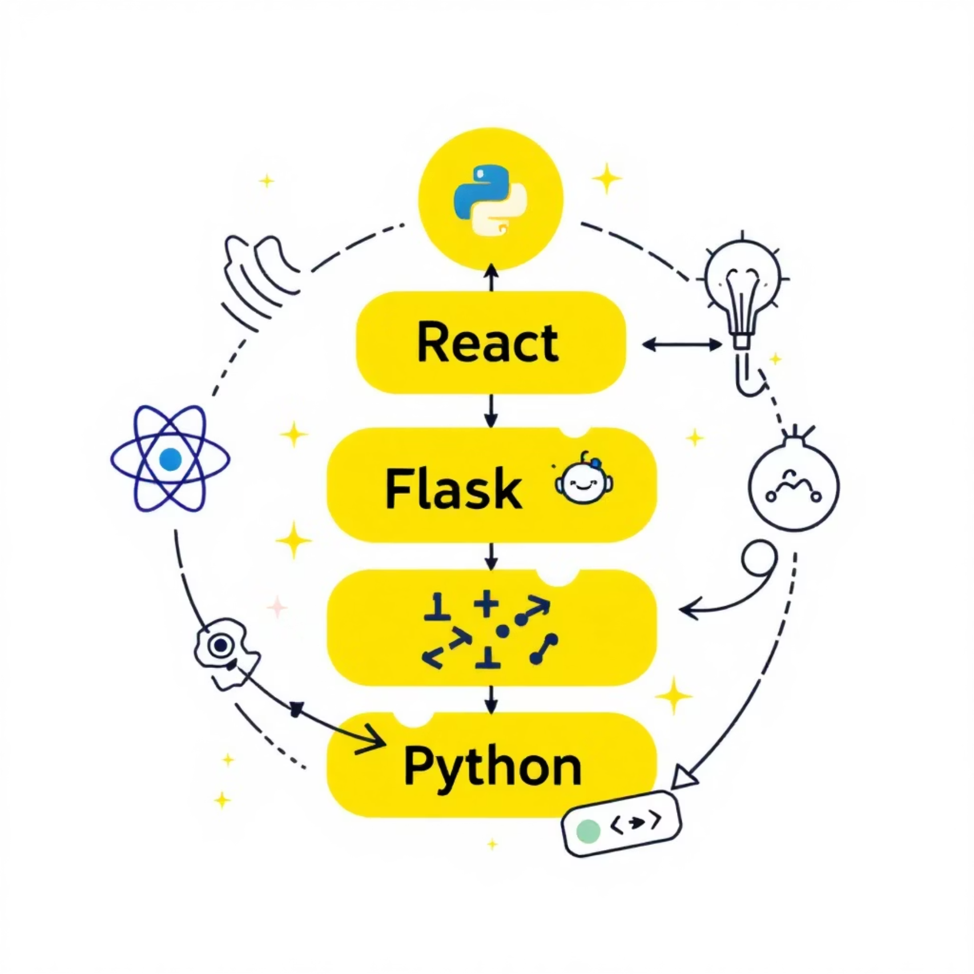

Technology Stack
Frontend Development
React.js with JSX Components powers the interactive user interface, delivering a responsive and modern web experience.
Backend Processing
Flask (Python) handles server-side logic, processes natural language input, and manages diagnostic algorithms.
Knowledge System
Symptom-Cause-Solution mapping database stores automotive expertise and diagnostic relationships for accurate results.
API Integration
REST API with Axios ensures seamless communication between frontend and backend components.

Slide 6






System Architecture
User Input
Car owner enters issue description through conversational text or chat interface
Frontend Processing
React frontend captures input and sends structured request to backend via REST API
Backend Analysis
Flask backend parses natural language, extracts brand, model, and symptom details using intelligent algorithms
Knowledge Matching
Expert database matches identified symptoms with probable causes and tested solutions
Smart Response
Results displayed in intuitive chatbot UI with color-coded message boxes for easy understanding

Slide 7











Key Features
Intelligent Detection
Natural Conversation
Complete Solutions
Automatically detects brand, model, and symptoms from natural language descriptions
Works with free-text input and handles friendly greetings like "hi" and "hello"
Provides both probable causes and practical solutions for every diagnosed issue
Friendly Interface
Modern Vehicle Support
Intuitive chatbot UI with error handling and helpful status icons
Handles issues for electric vehicles and hybrids alongside traditional cars

Slide 8


Real-World Example Scenarios
Dead Battery Scenario
"My Honda City battery is dead"
System Analysis: Cause → Battery is discharged or failing
Solution: Jumpstart vehicle or replace battery. Check alternator charging system.
Oil Leak Problem
"My BMW 3 Series has an oil leak"
System Analysis: Cause → Engine oil seepage from worn seals
Solution: Inspect gaskets, valve cover seals, oil pan, and oil filter for damage.

Slide 9





Additional Application Pages
About Page
Services Page
Comprehensive project overview explaining the expert system's capabilities and development approach
Complete listing of automotive services and diagnostic capabilities supported by the system
Vehicle Database
Contact & Authentication
Showcase 30+ supported vehicles with detailed engine specifications and diagnostic coverage
Contact forms for user queries plus sample login and registration pages for user management

Slide 10


Key Advantages
Cost & Time Savings
Saves time and money for car owners by providing instant preliminary diagnosis before costly mechanic visits
Virtual Car Assistant
Functions as a comprehensive virtual automotive assistant available 24/7 for immediate troubleshooting guidance
Reduced Dependency
Minimizes dependency on immediate mechanic consultations for basic diagnostic insights and initial problem assessment
Future Expansion
Platform ready for Machine Learning and AI enhancement to deliver even smarter, more accurate diagnostics

Slide 11

THANK YOU

